Slide 1
MEKONG DELTA PLAN: CASE STUDY
’
Strengthening strategic delta planning processes in Bangladesh, the Netherlands, Vietnam and beyond
Jake Brunner, Deputy Head, Southeast Asia Group
Delft, May 18-20, 2015

Slide 2
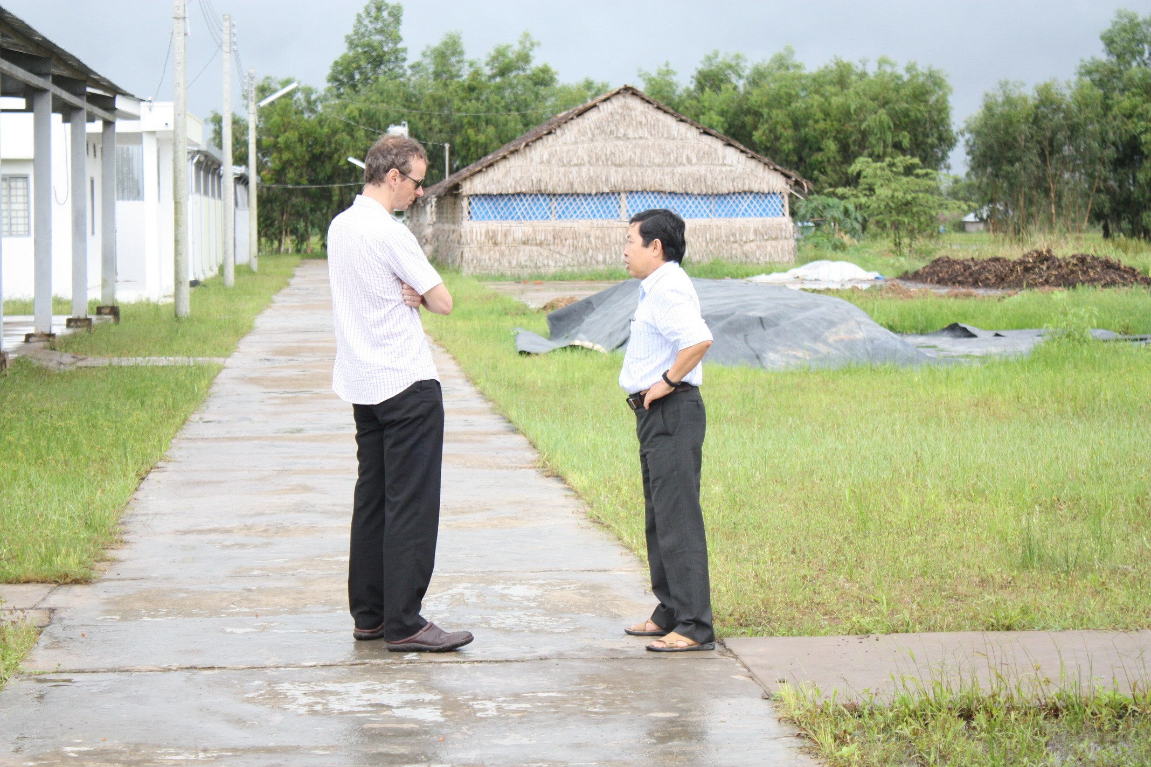
Dr. Duong Van Ni, Can Tho, September 2009

Slide 4
Timeline
October 2010: strategic partnership signed
March 2011: work starts on MDP
December 2013: submission of MDP to DPM
June 2014: PMs meet in Hanoi
February 2015: Mekong Delta Forum, HCMC
March 2015: design work starts on WB project

Slide 5
What is MDP?
Strategy not an action or master plan
Dutch experience added legitimacy
For first time, analyzed trade-offs
Questioned “rice at all costs” policy
Made case for “no-regrets” investments
Big expensive projects pushed to 2050-2100

Slide 6
Contextual factors
2009: Sinking Deltas, USGS visualization
2010: sharp slow down/rising inflation
2011: Mekong floods
2012: Thai rice pledge starts
2012: new Land Law
2014: oil price collapses
2015: DPs jointly support MDF

Slide 7
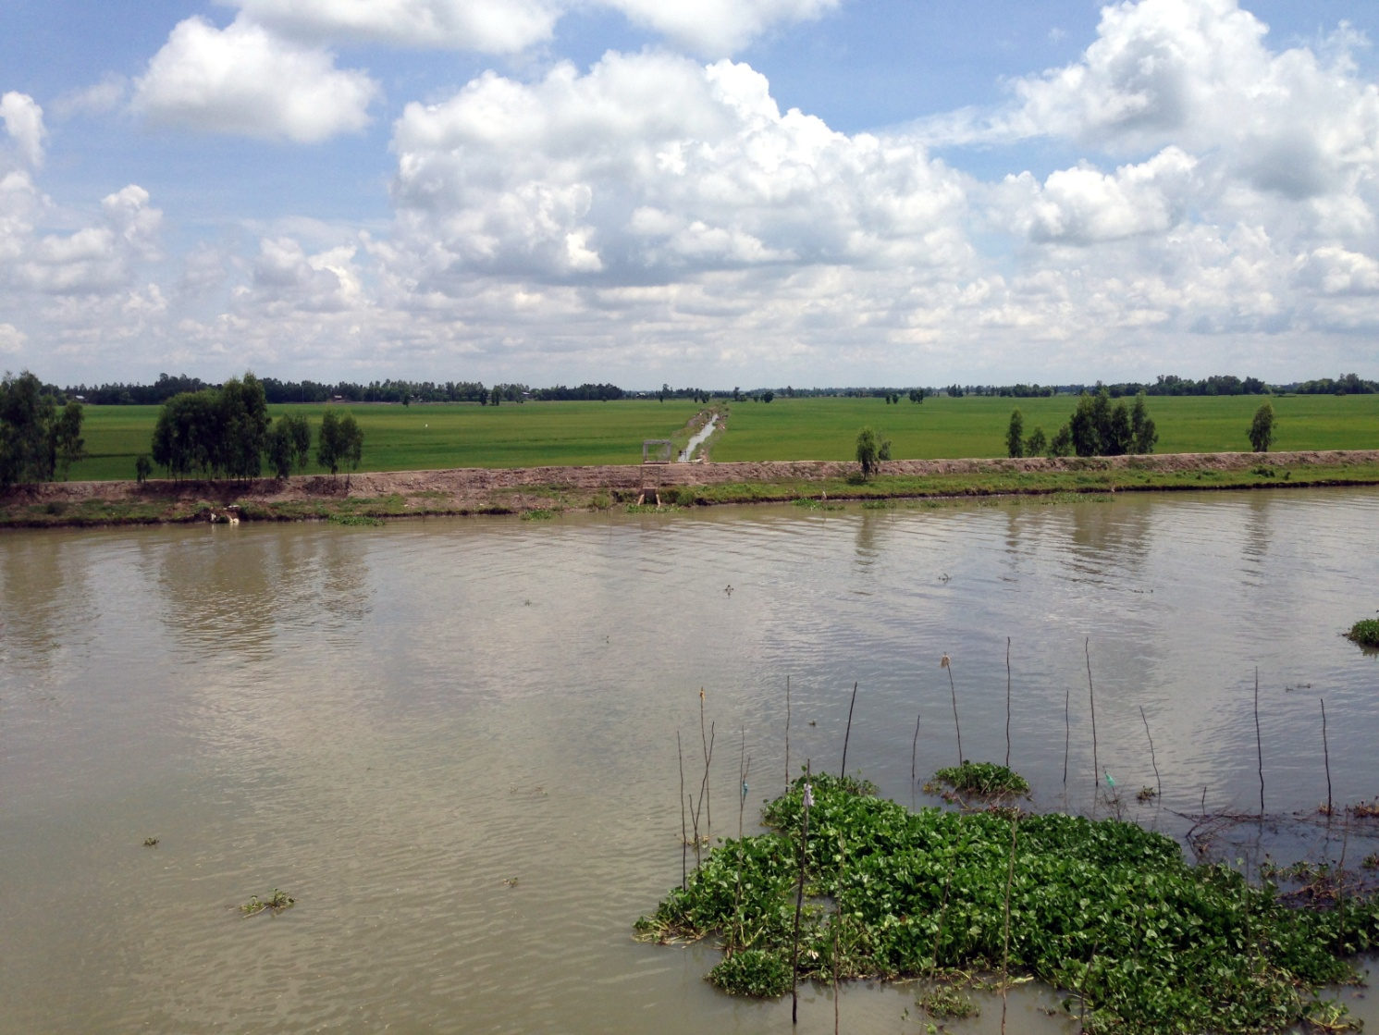
August dike, Dong Thap, May 2014

Slide 8
Key trade-offs/policy issues
Upper delta: third rice crop vs. water retention
Middle delta: rice vs. brackish aquaculture
Coastal delta: hard defense vs. adaptation
Inter-provincial/ministerial cooperation
Delta law on Dutch model?
Upstream dams

Slide 9
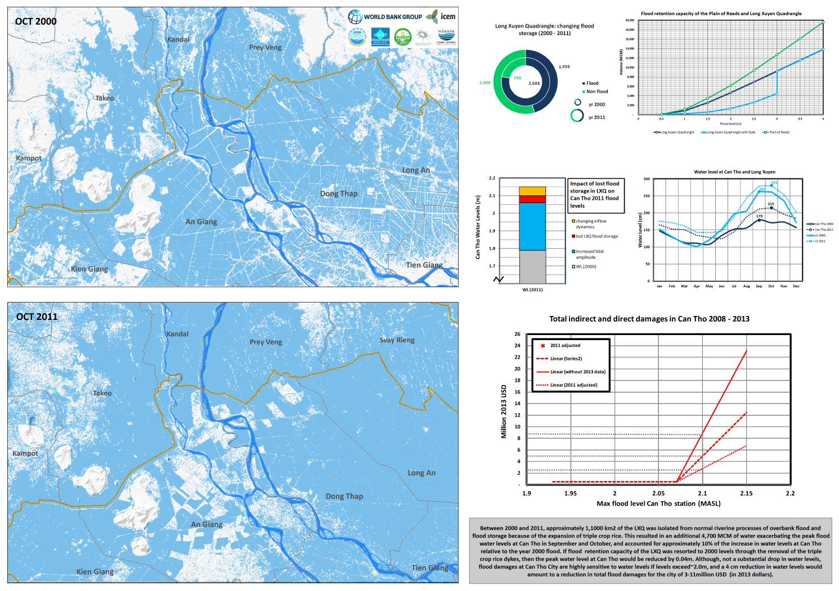

Slide 10
2000
2011

Slide 11
Cambodian border, An Giang, November 2014

Slide 12
Why is change so hard?

Slide 13
Embedding in society
Primacy of party resolutions
Vested interests endemic problem
Individual voices make little difference
Need to build consensus through:
Advisory groups/networks
Political engagement: SWSC, National Assembly
Media
Limited community participation in project design because don’t understand options

Slide 14
Knowledge-policy interface
Policy makers rely on universities and state research organizations
Narrow disciplinary biases result in selective use of information and lack of strategic thinking (“join the dots”), e.g., MDP vs MPs
Tradition of monopolizing/commercializing data and information limits learning

