Slide 1
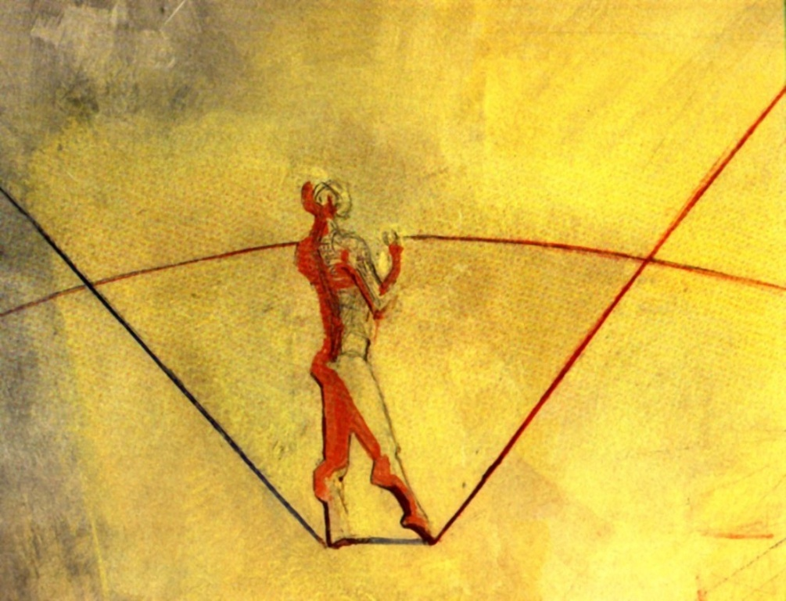
Pieter Bloemen - May 18 2015
Staff Delta Program Commissioner Netherlands
Visiting researcher UNESCO - IHE
Leading the
way
Leaving enough room
Strategic delta planning in the Netherlands
The Dutch Deltaprogram -
Notes:
1
1

Slide 2
Structure
Short intro in Deltaprogramme and Adaptive Delta Management
Three general remarks on the relation between the projectproposal (‘the fit of delta planning within society’) and the notion of socially robust solutions
Remarks about the three central elements
Stakeholder coalitions
Innovative solutions
Participatory processes

Slide 3
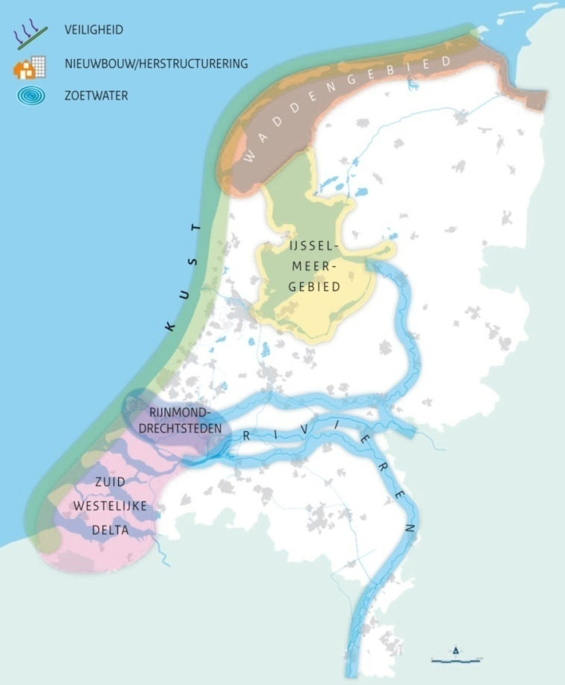
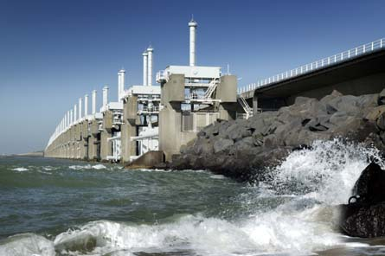
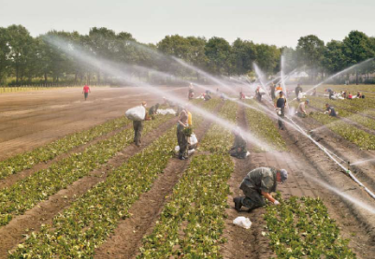
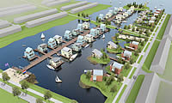
I
The Dutch Delta Program
Watersafety and freshwatersupply
Delta Act and Deltacommissioner
Delta Fund 1 billion euro/year
Delta Decisions in 2014: (+ reg. str.)
Safety standards + programme
Freshwater strategy + measures
Urban and spatial restructuring
2 region-specific decisions
Strategic delta pl.: - ADM (adapt., integr.) - Multi-level governan.

Slide 4
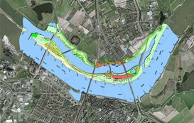
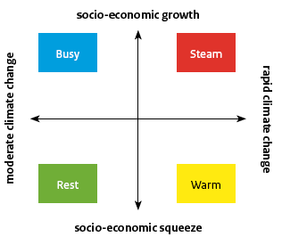
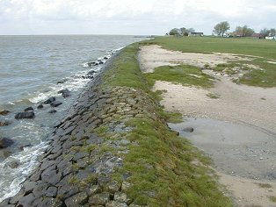
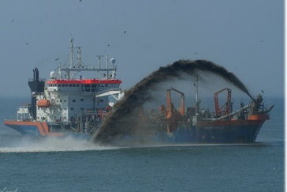
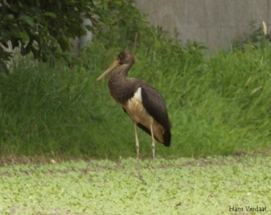
I
Four aspects of adaptive deltamanagement
1. Connecting ST-decisions (in broad physical domain) with LT-tasks (related to watersafety and freshwatersupply)
2. Thinking in adaptation-pathways instead of endsituations
3. Looking for and ‘rating’ flexibility
4. Linking with other investment-agenda’s (aging infrastructure, nature, urban development, recreation, shipping...)

Slide 5
Example ADM in Dutch Delta Program: freshwatersupply South-western Delta
I
2020
2050
2100
2020
2050
2100
Warm (rapid CC)
Busy (slow CC)
* A.o. Roode Vaart and optimization “Bernisse-Brielsemeer-systeem”
Prepare structural alternative supply
Structural alternative supply of fresh water to West NL. + regional measures and freshwater use*
Bubble-screen PLUS +
measures in regional watersystem and by freshwater users
Sluice HVliet
VZM fresh
Bubble-screen
KWA + step 1 en 2 **
regional measures and freshwater use*
KWA+ step 3**
+regional measures and freshwater use *
step 1: 15 m/s
step 2: 24 m/s
stap 3: > 24 m/s
** Possibly in combination with temporary closure of Hollandsche IJsselkering (in situation of storm or low river discharge rates)
Accept shortage +
regional measures and freshwater use *
Water conservation, more crop per drop etc.

Slide 6
“Strengthening strategic delta planning processes in Bangladesh, the Netherlands, Vietnam and beyond (*)”
II
Project proposal: “...crucial elements that together heavily influence the fit of delta planning within society:
Socially robust solutions
2
the formation and change over time of various stakeholder coalitions
the role of technological advances and innovative solutions in longer-term delta management processes
the availability of tools and approaches that support participatory processes to enable better connections between delta planners and their broader environment"
"In planning processes, social robust solutions could ideally refer to:
solutions that are accepted by all actors involved in planning processes - although solutions might change (e.g. costs, outlook, multifunctionality)
acceptance of the solution is maintained by the involved actors"
1
(*) Project in NWO Program “Urbanising Deltas of the World”
Notes:
'delta planners‘ → not a seperate category; e.g. regional subprogrammes, parliament, knowledge institutes, Staf DC
'planning processes‘ → only small part of the whole process of climate proofing; explicitly link with what preceeds (awareness of challenge - ARK, KfC, Second Deltacommission) and what follows (implementation - HWBP, RWS, waterboards)

Slide 7
II
Socially robust solutions –
looking in(to) the future
Prepare structural alternative supply
Bubble-screen PLUS +
measures in regional watersystem and by freshwater users
Structural alternative supply of fresh water to West NL. + regional measures and freshwater use*
Sluice HVliet
VZM fresh
Bubble-screen
KWA + step 1 en 2 **
regional measures and freshwater use*
KWA+ step 3**
+regional measures and freshwater use *
step 1: 15 m/s
step 2: 24 m/s
stap 3: > 24 m/s
Accept shortage +
regional measures and freshwater use *
Water conservation, more crop per drop etc.
Socially robust: looking into the future
… or in the future?
solutions that are accepted by all
actors involved in planning processes - although solutions might change (e.g. costs, outlook, multifunctionality)
acceptance of the solution is maintained by the involved actors"
Future actors might…
have other shared values
use other discountrates
have another risk attitude
3

Slide 8
III
Stakeholder coalitions
- in the Dutch Delta Program
X
1.
Yearly DP
report
Yearly Deltacongres
2.
Develop a growing ‘deltacommunity’
Joint fact finding
Shared values
Basic conditions
3.
Jointly develop and use the comparison system in the funelling process
2012: possible →
2013: preferential →
2014: preferred
Notes:
Redeneerlijn A. Stakeholder coalitions
NOT: each stakeholder bringing into the proces his or her own solution and energy geared to protect that solution, trying to plea, bargain and lobby his solution to the finish
BUT: build up, strengthen and expand a deltacommunity around shared values, a jointly developed set of criteria to the convergence proces in which possible solutions are seived and recombined to form a commonly agreed preferred strategy
Stakeholder coalitions change in time because each phase (policy development, planning, implementation etc.) attracts other parties

Slide 9
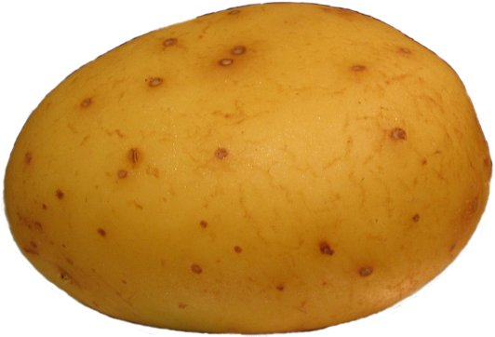
III
B. Innovative solutions
2020
2050
2100
2020
2050
2100
Warm (rapid CC)
Busy (slow CC)
* A.o. Roode Vaart and optimization “Bernisse-Brielsemeer-systeem”
Prepare structural alternative supply
Structural alternative supply of fresh water to West NL. + regional measures and freshwater use*
Bubble-screen PLUS +
measures in regional watersystem and by freshwater users
Sluice HVliet
VZM fresh
Bubble-screen
“Experts tend to be too optimistic about the actual implementation of a strategy - and too pessimistic about future innovations”
KWA + step 1 en 2 **
regional measures and freshwater use*
KWA+ step 3**
+regional measures and freshwater use *
step 1: 15 m/s
step 2: 24 m/s
stap 3: > 24 m/s
** Possibly in combination with temporary closure of Hollandsche IJsselkering (in situation of storm or low river discharge rates)
Accept shortage +
regional measures and freshwater use *
Water conservation, more crop per drop etc.

Slide 10
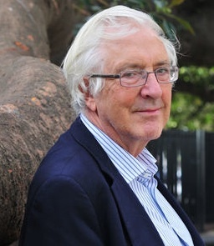
B. Innovative solutions
“Essentially by-products” → innovation
Jon Elster
Innovation can be a by-product of (amongst others):
Actions in general: serendipity (penicillin, champagne, LSD…)
Focussed: reacting to opportunities; mainly in private domain
Focussed: reactions to threats; mainly in public domain
Notes:
Redeneerlijn B. Innovation
Flexibility in strategy
to deal with unforeseen developments
to profit from innovations
After flooding: the present system has failed – you at least consider a new approach
Preventing flooding: the present system is doing well – why change?
Social robust: community changes: new safety approaches are national, projects are local (Katwijk)

Slide 11
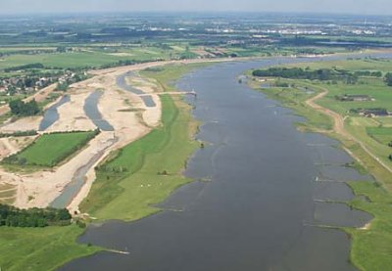
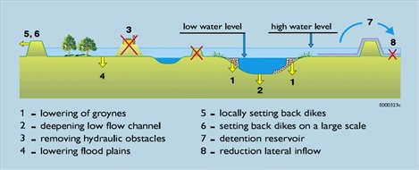
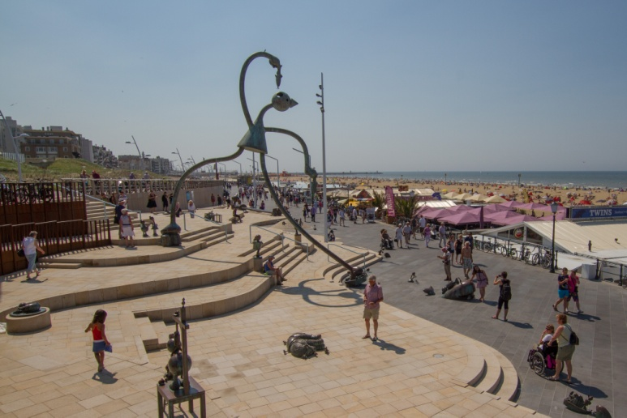
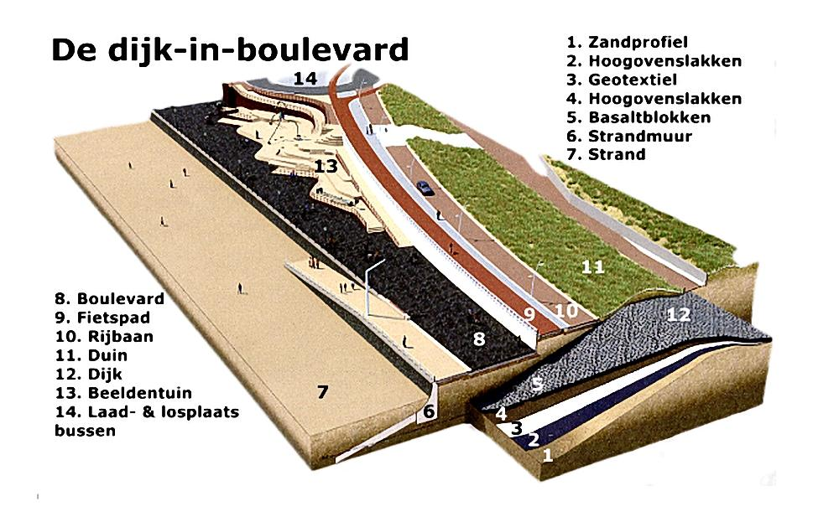
III
B. Innovative solutions
Action / innovation in public domain: threat + additional challenge
Safety against floodings:
+ spatial quality in rural landscape (a.o. environment)
→ Room for the River
+ spatial quality in urban landscape (a.o. recreation)
→ Dike in dune at the Boulevard of Scheveningen
→ Additional challenge generates new energy from new actors
→ Contributes to social robustness of the strategy

Slide 12
III
C. Participatory processes
Participation is NOT “sub-project 6B”
→ actively involving stakeholders in decisionmaking
inform about the situation, be clear about expectations
listen carefully, be open for suggestions
make explicit what you do, and what you do with suggestions
be transparant
Tools and approaches in the Dutch Delta Program (3 types)
multi level governance (vertical)
regional subprograms and regional steering groups (horizontal)
NGO’s (in OIM): advice before National Steering Group
Joint Fact Finding
all (reactions to) advices on website: SEA, scientific review, etc.
design workshops: Delta Atelier / Delta Design Platform
RftR: 'Building Blocks' model (Blokkendoos) → Deltamodel

Slide 13
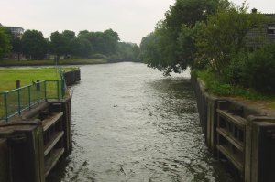
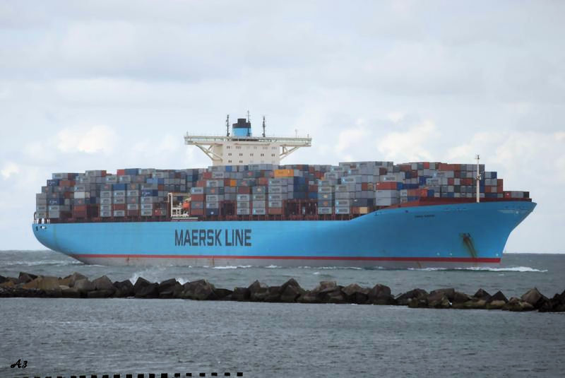
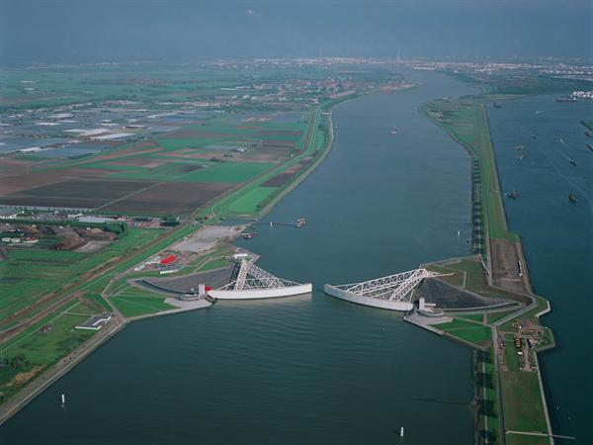
III
C. Participatory processes
2020
2050
2100
2020
2050
2100
warm
busy
* A.o. Roode Vaart and optimization “Bernisse-Brielsemeer-systeem”
Prepare structural alternative supply
Structural alternative supply of fresh water to West NL. + regional measures and freshwater use*
Bubble-screen PLUS +
measures in regional watersystem and by freshwater users
Sluice HVliet
VZM fresh
Bubble-screen
KWA + step 1 en 2 **
regional measures and freshwater use*
KWA+ step 3**
+regional measures and freshwater use *
step 1: 15 m/s
step 2: 24 m/s
stap 3: > 24 m/s
** Possibly in combination with temporary closure of Hollandsche IJsselkering (in situation of storm or low river discharge rates)
Accept shortage +
regional measures and freshwater use *
Water conservation, more crop per drop etc.
An adaptive strategy adresses more uncertainties than climate ch.
Enlarges possibilities to come to an agreement with new actors
Contributes to social robustness of the strategy
Staff Delta Programme Commissioner

Slide 14
THANKS FOR YOUR ATTENTION

